Slide 1
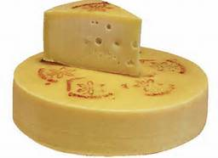
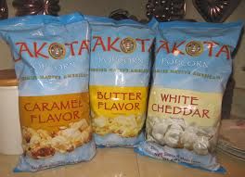
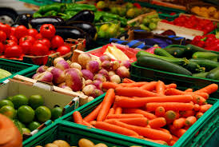
FY2016 Value-Added Producer Grant 101

Slide 2
Value-Added Producer Grant
Authorization
Section 231 of the Agriculture Risk Protection Act of 2000 (P. L. 106-224), as amended by section 6203 of the Agricultural Act of 2014 (P. L. 113-79)
(see 7 U.S.C. 1632a)
Program Regulation
Final Rule 7 CFR part 4284 subpart J
published May 8, 2015
Notes:
Note: 7 CFR 4284-A no longer applies to VAPG

Slide 3
Purpose
VAPG
Provides funds for economic planning activities or eligible working capital expenses to enable viable Agricultural Producers to develop businesses that produce and market Value-Added Agricultural Products and to create marketing opportunities for such businesses.

Slide 4
VAPG
National Competition
FY2016 Available Funding: $44 million
Application Deadlines:
June 24 for Grants.gov
July 1, for paper applications
Maximum Award Amounts
$75,000 Planning
$250,000 Working Capital
Matching Requirement
1-to-1 match (50 percent of total project costs) cash or eligible in-kind contributions to be used only for eligible project purposes.
Grant Period
Up to 36 months, depending on project complexity.

Slide 5
Priorities
VAPG
Priority Points (5 pts)
Beginning Farmers
Veteran Farmers
Socially Disadvantaged Farmers
Operators of Small-/Medium-Sized Farms Structured as Family Farms
Farmer or Rancher Cooperatives
Mid-Tier Value Chain Projects
Priority Points (up to 5 pts) ‘Group’ Applicants:’ Agricultural Producer Groups, Farmer or Rancher Cooperatives, Majority Controlled Producer-Based Businesses that ‘best contribute to creating or expanding marketing opportunities for Beginning, Socially-Disadvantaged, and Small-/Medium Family Farms.
Notes:
Note: No reserved funds in FY 2016

Slide 6
Basic Program Requirements
VAPG
Applicant eligibility
Project eligibility
Purpose eligibility
Other eligibility requirements
Evaluation criteria

Slide 7
Applicant Eligibility
VAPG
Applicant type
Multiple grant
Currently active grant
Reserve fund (as applicable)
Notes:
General eligibility components include citizenship, legal authority and responsibility.

Slide 8
VAPG
Applicants must be Agricultural Producers:
An individual or entity that produces an Agricultural Commodity through participation in the day-to-day labor, management, and field operations; or that has the legal right to harvest an Agricultural Commodity that is the subject of the VAPG project
Notes:
Particular attention to the part about what constitutes ‘direct engagement’

Slide 9
Four Eligible Applicant Types
VAPG
Independent Producers
Agricultural Producer Groups
Farmer or Rancher Cooperatives
Majority-Controlled Producer-Based Businesses

Slide 10
Independent Producer
VAPG
An individual agricultural producer or an entity that is solely owned and controlled by agricultural producers, that are directly engaged in the production of the subject agricultural commodity*.

Slide 11
Independent Producer…
VAPG
An independent producer entity may be a steering committee of individual IPs who will form a legal entity that meets the requirements of one of the 4 eligible applicant types.
An independent producer may be an agricultural harvester if they have the legal right to harvest a primary (not residual) commodity. Examples: commercial fishermen, loggers.
Notes:
Steering committee must form a legal entity prior to obligation.
A harvester is NOT a gleaner or anyone who collects residual commodity (slash from forest, for example) after the primary commodity has been harvested.

Slide 12
Agricultural Producer Group
VAPG
Formal nonprofit membership organization that represents Agriculture Producers that meet the VAPG program definition requirements for an Independent Producer and operates with a mission that includes working on behalf of Independent Producers.
The majority of the applicant’s membership meet the definition of Independent Producer.
The majority of the applicant’s board of directors meet the definition of Independent Producer.
Notes:
Think state or national commodity or farmer’s organizations.

Slide 13
Farmer or Rancher Cooperatives
VAPG
A business owned and controlled by agricultural producers that is incorporated, or otherwise identified by the state in which it operates, as a cooperatively operated business.*
*Note that agricultural harvesters do not meet the definition of a farmer or rancher and therefore are not eligible to apply as Farmer or Rancher Cooperatives.
Notes:
Note: some states do not have separate incorporation statutes for cooperatives, but do recognize businesses that are organized and operate on a cooperative basis: owned and controlled by the members who use it, with revenue distributed on the basis of use of the cooperative.

Slide 14
Majority-Controlled Producer-Based Business*
VAPG
The majority of the financial and voting interest belongs to Independent Producers.
*Only 10 percent of available funds will be awarded to eligible applicants in this category.
Notes:
Non-independent producers likely to be investors.

Slide 15
All Four Applicant Types Must :
VAPG
Currently produce and own more than 50 percent of the raw commodity that will be used for the Value-Added product.
Own the product from its raw commodity state through the production of the Value-Added product during the Project (except for MTVC).

Slide 16
Emerging Market
Agricultural Producer Groups, Farmer or Rancher Cooperatives, and Majority-Controlled Producer-Based Businesses, must show that they are entering an emerging market as a result of the proposed project.
Applicants cannot have supplied the proposed product, geographic or demographic market for more than two years at time of application submission.

Slide 17
Multiple Grant Eligibility
Applicants (including separate, but related entities with greater than 75% common ownership) may not submit more than one application in response to this solicitation (see additional guidance in Final Rule).
Applicants for Working Capital grants may not submit applications for the same project that has previously received Working Capital funds.

Slide 18
Currently Active Grant
Applicants with an active value-added grant must close out that grant within 90 days of the application deadline to be eligible for the subsequent competition

Slide 19
Project Eligibility
Value-added product methodology
Expansion of customer base
Increased revenue from the process returned to the producer

Slide 20
Five Value-Added Methodologies
VAPG
Change in physical state
Produced in a manner that enhances the value of the agricultural commodity
Physical segregation
Farm- or ranch-based renewable energy
Locally-produced agricultural food product

Slide 21
Change in Physical State
VAPG
An irreversible processing activity that alters the raw agricultural commodity and enhances its value and is something other than a post-harvest process that primarily acts to preserve the commodity for later sale.
Examples include, but are not limited to-
milk into cheese
wheat into flour
wool into clothing or rugs
corn into E-85 ethanol
livestock into packaged meat

Slide 22
Produced in a manner that enhances the value of the agricultural commodity
VAPG
The value-added product results from the use of a recognizably coherent set of agricultural production practices in the growing of the raw agricultural commodity, such that a differentiated market identity is created for the resulting product.
Nonstandard production method that adds value per unit of production over a standard production method, and demonstrates this by a quantifiable comparison with products produced in the standard manner.
Examples include, but are not limited to-
organic carrots,
eggs produced from free-range chickens.

Slide 23
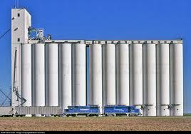
Physical Segregation
VAPG
Value-added product results from physically separating (i.e. distance or structure) the agricultural commodity from other varieties of the same commodity on the same farm during production and harvesting, with continued separation during the processing and marketing of the value-added product.
Example: GMO corn separated from non-GMO corn on the farm during production and harvesting, with continued separation through marketing.

Slide 24
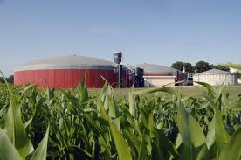
Farm- or Ranch-Based Renewable Energy
VAPG
An agricultural commodity that is used to generate renewable energy on a farm or ranch owned or leased by the independent producer applicant that produces the agricultural commodity.
Examples include, but are not limited to-
dairy manure into methane and
electricity generated on the farm
corn into biodiesel generated on the
farm.
Generation of energy from wind, solar,
geothermal or hydro sources are not eligible.
Notes:
Actual language is “is a source of Farm- or Ranch-based Renewable Energy.”

Slide 25
Locally-Produced Agricultural Food Product
VAPG
Any agricultural food product that is marketed and distributed within 400 miles of the product’s origin or within the State in which the product is produced.
Examples include, but are not limited to-
specific local grapes with characteristics attributable to the growing area sold to a winery that will produce a local wine;
local sweet corn advertised and sold at a premium as a fresher locally-produced alternative to non-local produce.
Notes:
Food for human consumption only.

Slide 26
All applicants must demonstrate:
Increase in customer base
Greater portion of revenue derived from the value-added process returned to the producer.

Slide 27
Expansion of customer base
Include baseline of current customers for the commodity or value-added product;
Include estimated target number of customers that will result from the project

Slide 28
Greater portion of revenue
returned to producers
Include a baseline of current revenues from the sale of the agricultural commodity or value-added product;
Include an estimated target of increased revenues that will result from the project.

Slide 29
Purpose Eligibility
2 types of grants
Use of funds
Budget & work plan

Slide 30
VAPG
2 Types of VAPG Grants
Planning Grant
To pay a qualified (third-party) consultant for development of feasibility, marketing, business plan related to the processing and/or marketing of a value-added product.
2) Working Capital Grant
To pay eligible project expenses related to the processing and/or marketing of a value-added product.

Slide 31
VAPG
Variations on Working Capital Grants
Requests of $50,000 or more
(emerging market proposals)
All applicant types;
Must provide a third-party, project-specific feasibility study and a business plan related to the processing and/or marketing of the value-added product.
Notes:
Emerging market is required for all applicant types EXCEPT Independent Producers. However, Ips proposing emerging market projects must also submit a feasibility study and business plan.

Slide 32
VAPG
Variations on Working Capital Grants
2. Requests of $50,000 or more
(market expansion)
Independent Producer (IP) applicants only;
Proposing market expansion of an existing value-added product that they have produced and successfully marketed for at least two years at time of application; and
In lieu of an independent feasibility study for this project, must submit a business or marketing plan for the value-added project .
Notes:
Recall that IP’s are not subject to ‘emerging market’ requirement.
This does not change the proposal evaluation or scoring elements and must demonstrate the expected increases in customer base and revenue returns to the producer applicants supplying the majority of the agricultural commodity for the project.

Slide 33
VAPG
Variations on Working Capital Grants
3. Applications requesting less than $50,000 (Simplified)
All applicant types;
Not required to provide a feasibility study and business plan, but must demonstrate the expected increases in customer base and revenue returns to the producer applicants supplying the majority of the agricultural commodity for the project.
Notes:
This does not change the proposal evaluation or scoring elements and must demonstrate the expected increases in customer base and revenue returns to the producer applicants supplying the majority of the agricultural commodity for the project in

Slide 34
Purpose Eligibility
VAPG
Use of Funds
Costs for eligible activities (see 4284.923) include but are not limited to:
Processing costs including labor, utilities, packaging and labeling, ingredients;
Additional raw commodity inventory from third parties (up 49% of the total amount required for the project)
Advertising and promotion
Financial/accounting systems
Notes:
Note: Use of grant funds to pay labor and salary expenses of the applicant (applicant’s representative) or applicant family members is not allowable. However, these costs may be used as a matching contribution up to 25% of total project costs.

Slide 35
Purpose Eligibility
VAPG
Use of Funds
Costs for ineligible activities (see 7 CFR 4284.924) include but are not limited to:
Purchase of land, buildings or equipment
Preparation of the grant application,
Research and development, architectural or engineering design work
Expenses for the production, harvesting or delivery to a processing facility of any agricultural commodity or product

Slide 36
Use of Funds
VAPG
Applications with ineligible expenses of more than 10 percent of total project costs will be ineligible to compete for funds.
Applications selected for award that contain ineligible expenses of 10 percent or less of total project costs must remove those ineligible expenses from the final project budget.

Slide 37
Work Plan & Budget
Provide a detailed work plan and budget that shows:
how the project’s goals will be accomplished including a narrative description of the eligible activities and associated tasks;
a budget breakdown of estimated costs allocated to those activities and tasks;
identification of the key personnel responsible for overseeing and/or conducting the activities or tasks
Notes:
Work Plan & Budget is both an eligibility requirement AND a scoring criterion.

Slide 38
Work Plan & Budget
timeframes for completion of activities and tasks;
identification of the sources and uses of grant and matching funds for all activities and tasks; and
a grant period that meets start and end date requirements.

Slide 39
Work Plan & Budget
If Program Income is earned during the grant period as a result of the project activities, it must be managed and reported accordingly.
See 2 CFR 200.306.
Program Income means gross income earned by the grantee that is directly generated by a supported activity or earned as a result of the grant, including, but not limited to income from the sale of commodities or products produced under the grant.

Slide 40
Matching Funds must be…
Equal to at least the grant amount (at least 50 percent of total project costs).
Spent only on eligible expenses;
Spent in advance of grant funding (for every dollar of grant funds disbursed, not less than an equal amount of matching funds will have been expended prior to submitting the request for reimbursement);
From eligible sources without a real or apparent conflict of interest

Slide 41
Matching Funds
Must be in the form of:
Applicant cash, loan, or line of credit; and/or
Applicant or family member in-kind contributions of goods or services (applicant provided services limited to 25 percent of total project costs); and/or
Third-party cash or
Third-party in-kind contribution, including non-federal grant sources.

Slide 42
Matching funds must be verified at application and confirmed at award:
Equals at least 50% of total project cost
From an eligible source
For an eligible use
Available during the grant period

Slide 43
Other Eligibility Requirements
VAPG
Grant Period
Completeness

Slide 44
Grant Period Eligibility
VAPG
Maximum timeframe of 36 months in length from the date of award (date of grant agreement execution). Note: this is not open-ended. Each project’s grant period will be based on the project’s complexity, as indicated in the application work plan.
Extensions of up to 12 months will be considered only if for unavoidable or unforeseen circumstances. (Note: no grant may extend beyond 36 months, therefore no extension is available for grants with 36 month grant periods).

Slide 45
Completeness Eligibility
VAPG
Applications must contain all required elements to be eligible to compete for funds.
Information submitted after the application deadline will not be accepted.

Slide 46
Evaluation Criteria
Performance evaluation criteria
Proposal evaluation criteria

Slide 47
Performance Evaluation Criteria
Applicant suggests one or more relevant criterion to be used to evaluate whether or not the primary goals and objectives of the project are being met.
All applicants estimate how many jobs are expected to be created or saved as a result of the project?
Working capital applicants record data on expansion of customer base and increase in revenue from the Applicant eligibility section.

Slide 48
Proposal Evaluation Criteria

Slide 49
Proposal Evaluation Criteria
The Agency selects and ranks applications based on responses to 5 criteria:
Nature of the proposed project (0-30)
Qualifications of project personnel (0-20)
Commitments and support (0-10)
Work plan and budget (0-20)
Priority points (0 or 5/up to 5 additional)

Slide 50
Priority Points
5 priority points will be awarded to all applicants that request the priority points and demonstrate eligibility for one of the following priority categories:
Beginning Farmer or Rancher*
Socially Disadvantaged Farmer or Rancher*
Mid-Tier Value Chain Project
Small- or Medium-sized Farm structured as a Family Farm
Farmer or Rancher Cooperative
*For BFR and SDFR priority points, applicant ownership or membership must be more than 50% BFRs or SDFRs, respectively.

Slide 51
Priority Points
Up to 5 points additional points will be awarded to Agricultural Producer Groups, Farmer or Rancher Cooperatives, and Majority Controlled Producer-Based Businesses that propose projects that best contribute to new or expanded marketing opportunities for:
Beginning Farmers or Ranchers
Veteran Farmers or Ranchers*
Socially-Disadvantaged Farmers or Ranchers
Small- or Medium-Sized Family Farms

Slide 52
QUESTIONS?

Slide 53
Tools for Applicants
VAPG

Slide 54
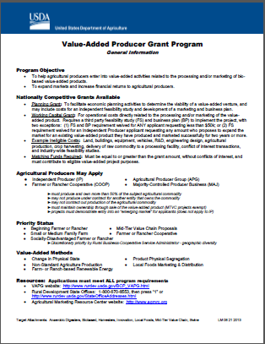
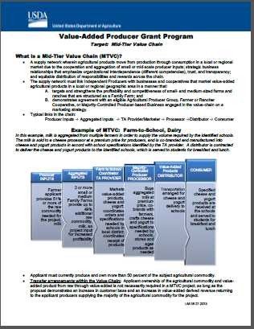
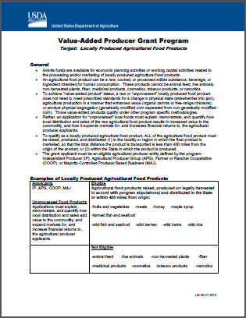
Tools
Outreach Fact sheets
General program Info
Locally-produced food
Harvesters
Mid-tier value chains

Slide 55
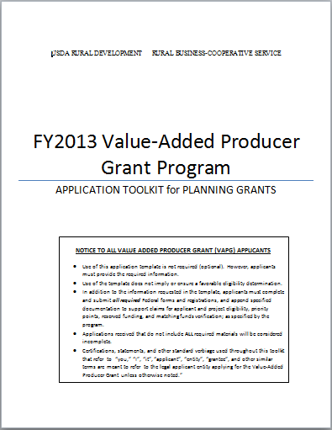
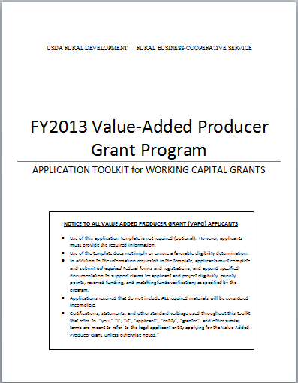
VAPG
Comprehensive Toolkits for Planning and Working Capital

Slide 56
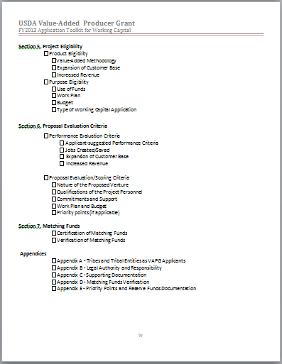
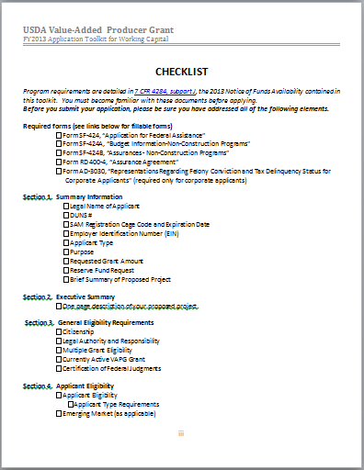
Checklists to ensure complete applications

Slide 57
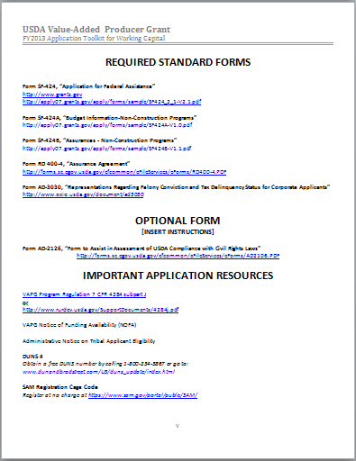
Links to required forms and necessary resources, including:
SF 424s
AD 3030
Program regulation
NOFA
And more!

Slide 58
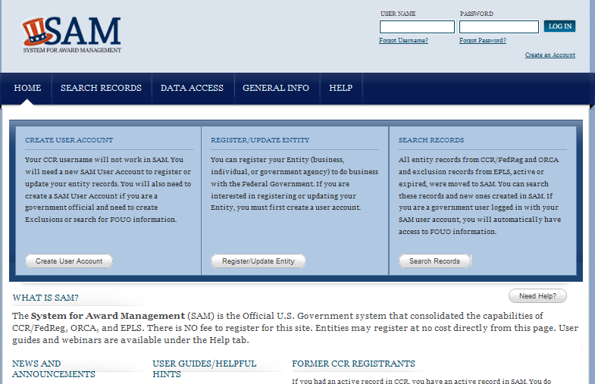
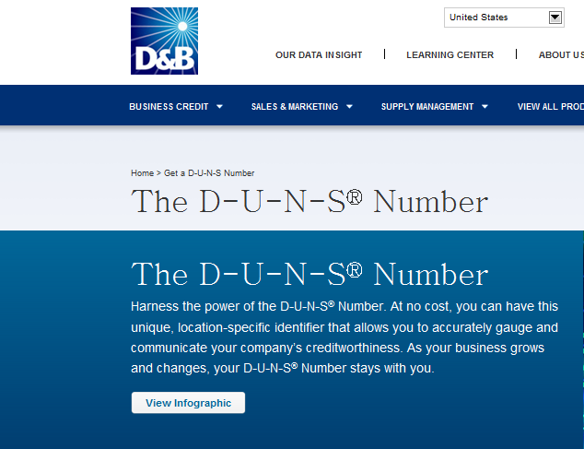
Links to DUNS and SAM
Notes:
To ensure that applicants get to the free DUNS and SAM registration pages, avoiding fee-based middlemen.

Slide 59
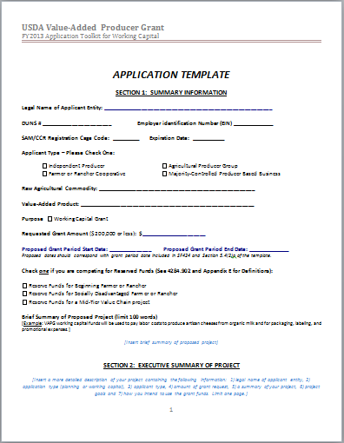
Individual OPTIONAL templates for Planning and Working Capital applications.
Notes:
Check boxes and narrative insertion points
Hyperlinks to reg throughout

Slide 60
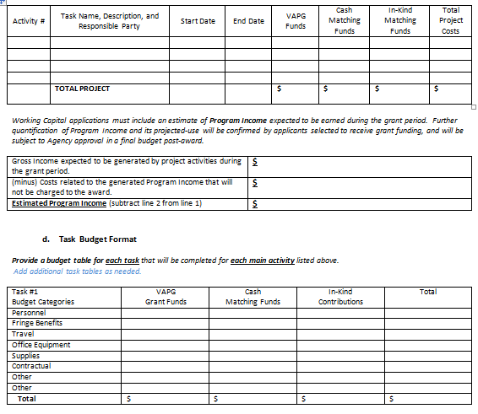
Simplified Budget Templates
Program Income estimate (WC only)
Individual Task Budget Templates

Slide 61
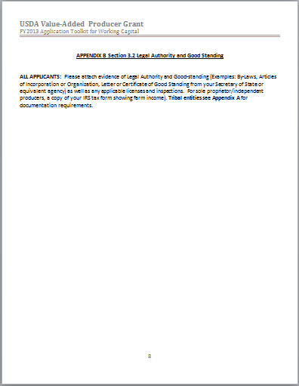
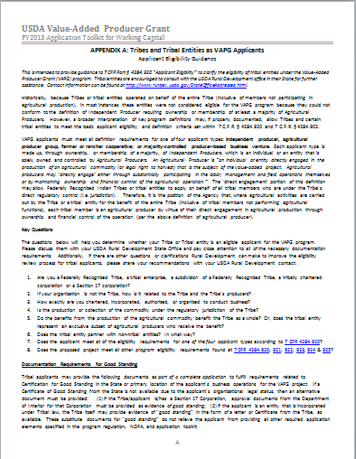
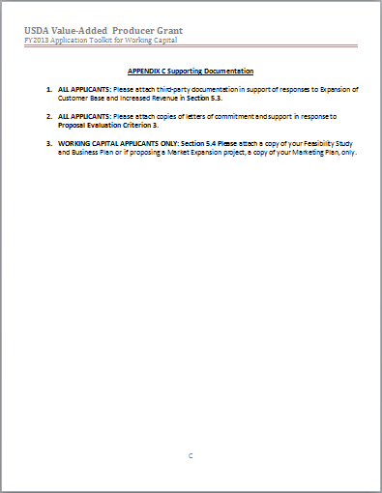
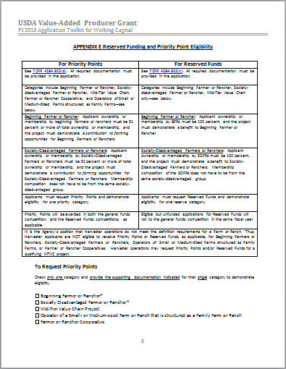
Appendices
Guidance for tribal applicants
Attachment points for required documentation
Matching fund verification templates
Reserve fund eligibility and priority point guidance

Slide 62
QUESTIONS?

